Slide 1
Capstone Project: Bike Sharing Demand Prediction
Team members:
Rohan Dhunde

Slide 2
problem Descreption
The use of rental bikes in cities has made transportation more convenient, but ensuring a stable supply of bikes is important.
To achieve this, we need to predict the number of bikes required each hour by analyzing usage patterns and factors that influence demand.
Machine learning techniques like regression and time series analysis can help build accurate predictive models. By doing so, we can ensure that rental bikes are available to the public when they need.

Slide 3
Business Understanding
Bike rentals have become a popular service due to their affordability and convenience.
They are especially popular among people without personal vehicles and those looking to avoid crowded public transportation.
To ensure the success and profitability of the bike rental business, it's important to have a stable supply of bikes at different locations to meet demand.
Our project aims to create a pre-planned set of bike count values to ensure that demand is met at all times.

Slide 4
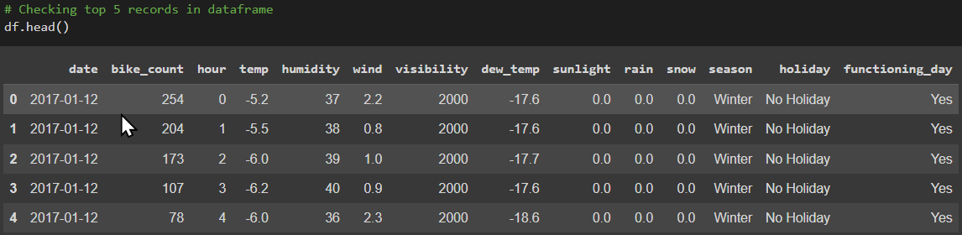
Data summary and first look OF THE DATASET
▪ This Dataset contain 8760 rows and 14 columns.
▪ Three categorical features ‘Seasons’, ‘Holiday’, & ‘Functioning Day’.
▪ One Datetime column ‘Date’.
We have some numerical type variables such as temperature, humidity, wind, visibility, dew point temp, solar radiation, rainfall, snowfall which shows the environmental conditions for that particular hour of the day.

Slide 5
Data summary
there are no missing valus present
There are no duplicate values in dataset
There are no null values
There dependent variable is rented_bike_count which we need to prediction on
The data shows hourly rentals data for one year
We changed the name of some features for our convenience, they are as follows ‘date', 'Bike_Count', 'Hour’, ‘temp’, ‘humidity', ‘wind', ‘visibility’, ‘dew_temp’, ‘sunlight’, rain', ‘snow', ‘seasons', ‘holiday', ‘functioning_day’.

Slide 6
Feature types
Features
VariableTARGET VARIABLE
.
NUMERIC | CATEGORICAL
1.Hour | 1.Season
2.Temp | 2.Holiday
3.Humadity | 3.Functioning Time
4.Dew_temp | 4Timeshift
5.Sunlight
6.Rain
7.Show
BIKE COUNT

Slide 7
Feature Summary
• Date : Year-Month-Day • Rented Bike Count - Count of bikes rented at each hour • Hour - Hour of the day • Temperature - Temperature in Celsius • Humidity - % • Wind Speed - m/s • Visibility - 10m • Dew point temperature -Celsius • Solar radiation -MJ/m2 • Rainfall -mm • Snowfall –cm • Seasons -Winter, Spring, Summer, Autumn • Holiday -Holiday/No Holiday • Functional Day - NoFunc(Non Functional Hrs),Fun(Functional Hrs)

Slide 8
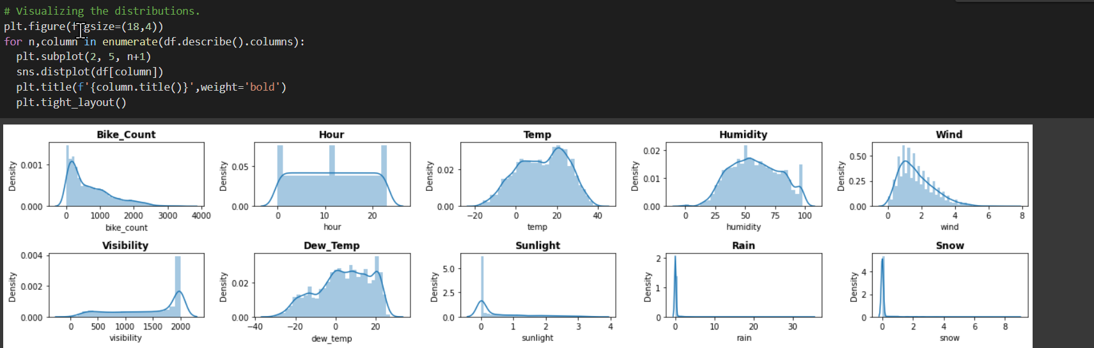
Distribution Visualization

Slide 9
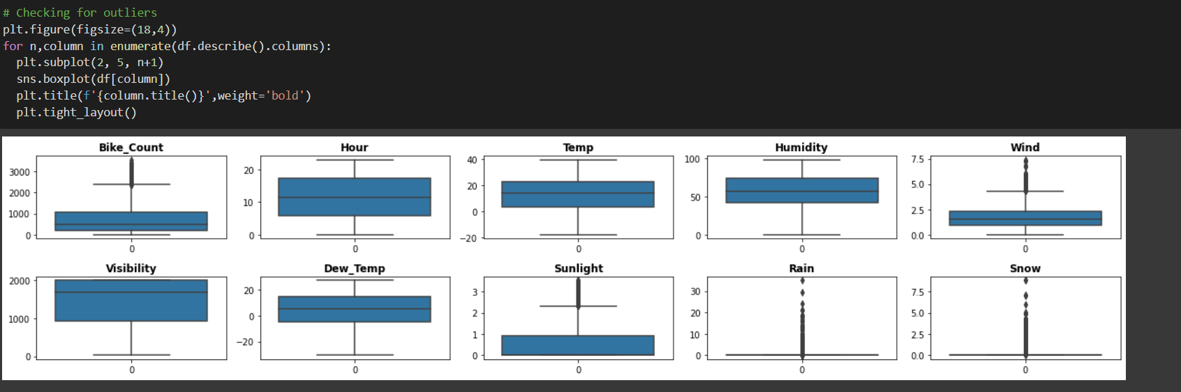
Checking Outliers
.

Slide 10
CHECKING OUTLIERS
▪ We see outliers in some columns like Sunlight, Wind, Rain and Snow but lets not treat them because they may not be outliers as snowfall, rainfall etc. themselves are rare event in some countries.
▪ we treated the outliers in the target variable by capping them with the interquartile range (IQR) limits.

Slide 11
Data Manupulation
▪"Weekend" is a new feature added to the dataset which indicates whether it's a weekend or not. It takes the value 1 for Saturdays and Sundays and 0 for other days of the week.
▪ "Time shift" is another new feature added to the dataset, which categorizes time intervals into three values: Night, Day, and Evening.
▪ The "date" column was dropped from the dataset as it was no longer necessary, and we had already extracted useful features from it.

Slide 12
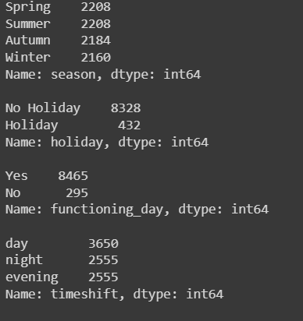
MANIPULATING THE DATASET
▪ Defined a label encoder to replace the string values in the columns with some numeric values.
▪ Replaced holiday with 1 and No holiday with 0.
▪ Replaced Yes with 1 and No with 0 in
functioning _day column.
▪ In the time shift column we replaced night with 0,
day with 1 and evening with 2.
▪ Created dummy features from the season column named summer, autumn, spring and winter with one hot encoding.

Slide 13
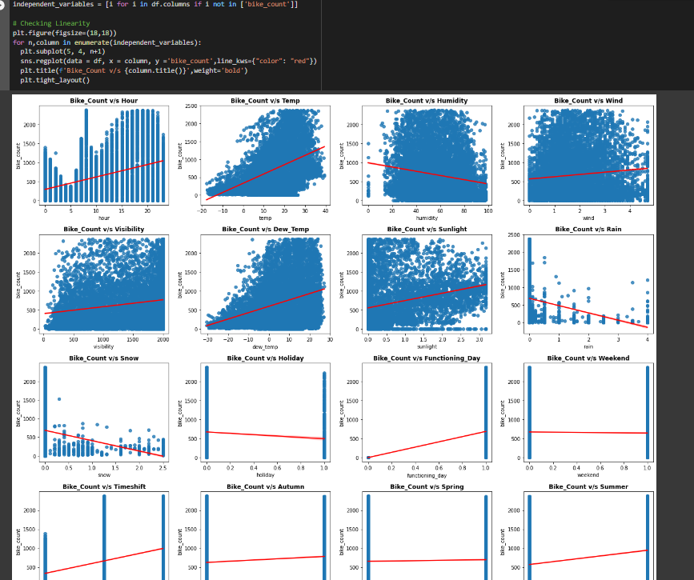
CHECKING LINEARITY IN DATA

Slide 14
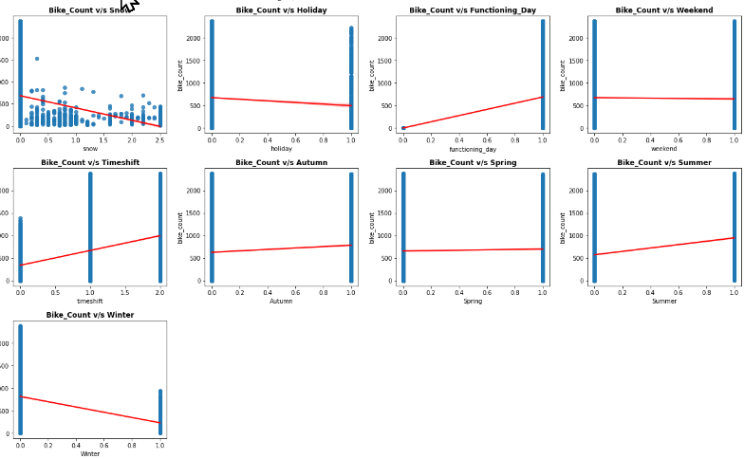
CHECKING LINEARITY IN DATA

Slide 15
CHECKING LINEARITY IN DATA
We analyzed the visualizations and found that several factors have a positive correlation with the bike_count, including hour, temperature, sunlight, and dew_temp. This means that as these factors increase, the bike_count is likely to increase as well. However, some factors have a negative correlation with the bike_count, including humidity, rain, snow, and winter features. This suggests that as these factors increase, the bike_count is likely to decrease.
Moreover, we observed that some features have little to no correlation with the bike_count, as evidenced by the regression line being relatively flat. This indicates that these factors may not have a significant impact on the bike_count. By identifying these correlations, we can better understand the factors that influence bike rental demand and use this information to create more accurate predictive models.

Slide 16
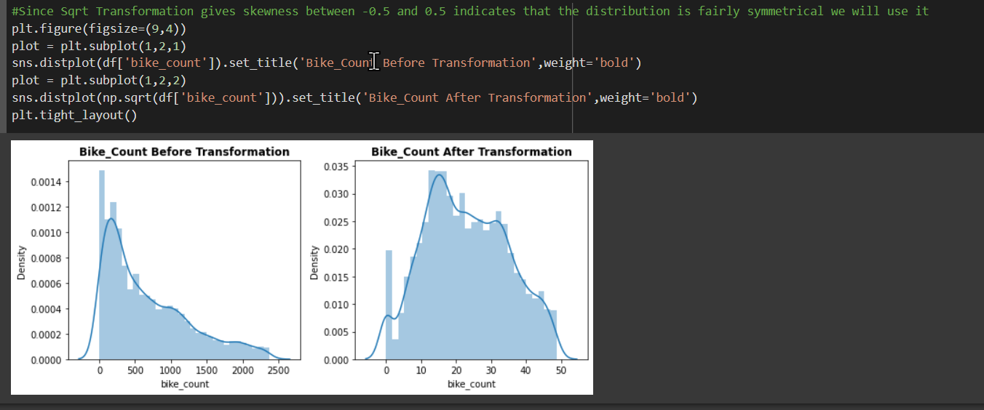
DEPENDENT VARIABLE

Slide 17
DEPENDENT VARIABLE
The initial distribution of the target variable was not normally distributed, as indicated by a skewness value of 0.983.
Log transformation was attempted to address this issue, but it was not successful.
Square root transformation was then applied and was found to be effective in improving the normality of the distribution, as indicated by a lower skewness value of 0.153. This transformation can help to improve the accuracy and reliability of statistical analysis and modeling.

Slide 18
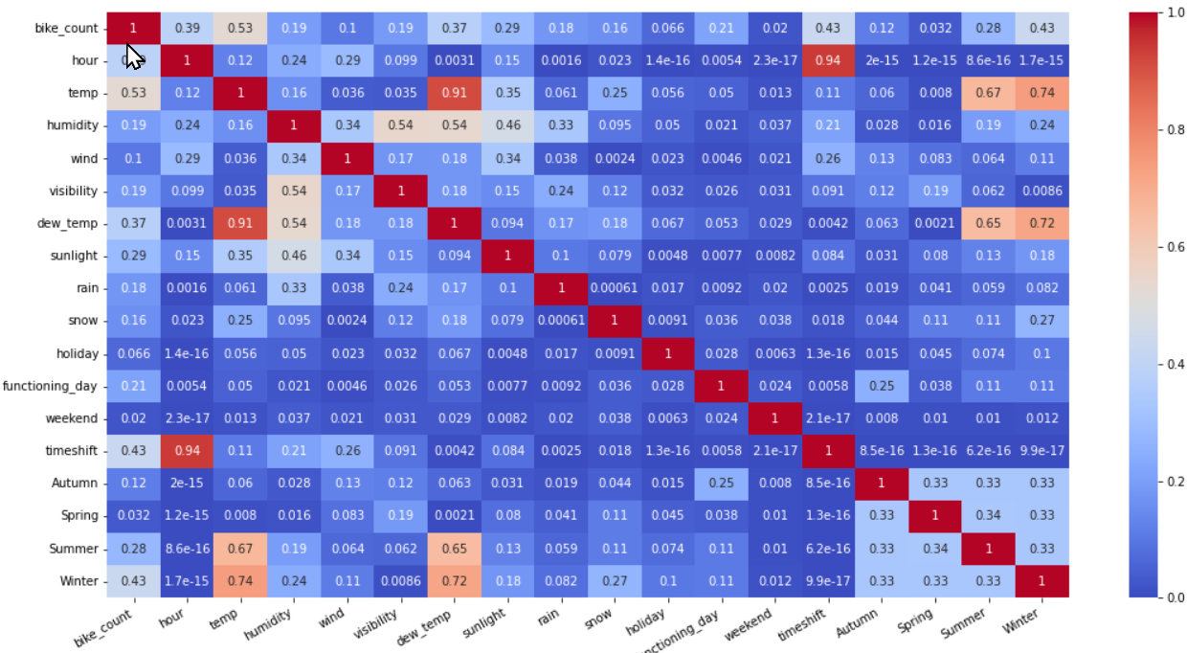
MULTICOLLINEARITY ANALYSIS

Slide 19
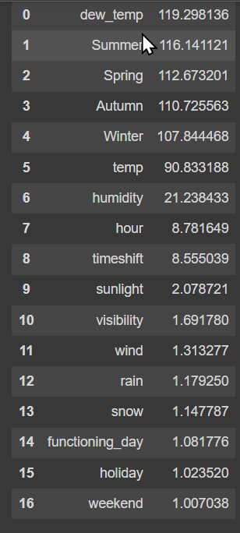
HANDLING MULTICOLLINEARITY
▪ Correlation is a statistical technique that enables the examination of relationships between variables and explains the strength and direction of these relationships. Multicollinearity refers to the presence of high correlation between two or more independent variables in a regression model.
▪ For instance, in our dataset, the variables Dew_temp and Temp show high correlation, as do Hour and Timeshift.
▪ To address this multicollinearity, we can exclude the highly correlated features from our dataset and calculate the variance inflation factors (VIF).
▪ VIF is a measure of the strength of correlation between independent variables in a regression model. It is determined by regressing each variable against every other variable in the dataset, and the VIF score of a variable indicates how well the variable is explained by the other independent variables.

Slide 20
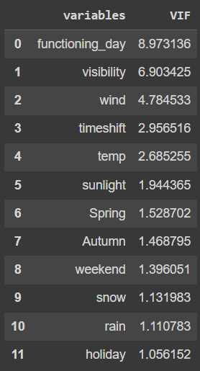
HANDLING MULTICOLLINEARITY
▪ The features Summer and Winter can also be determined based on temperature, which is already included in the dataset. Therefore, dropping these features will not result in any significant loss of useful information.
▪ We also excluded features with VIF > 10, which helped to reduce multicollinearity and improve the accuracy of our regression model. After this process, we obtained the following results.

Slide 21
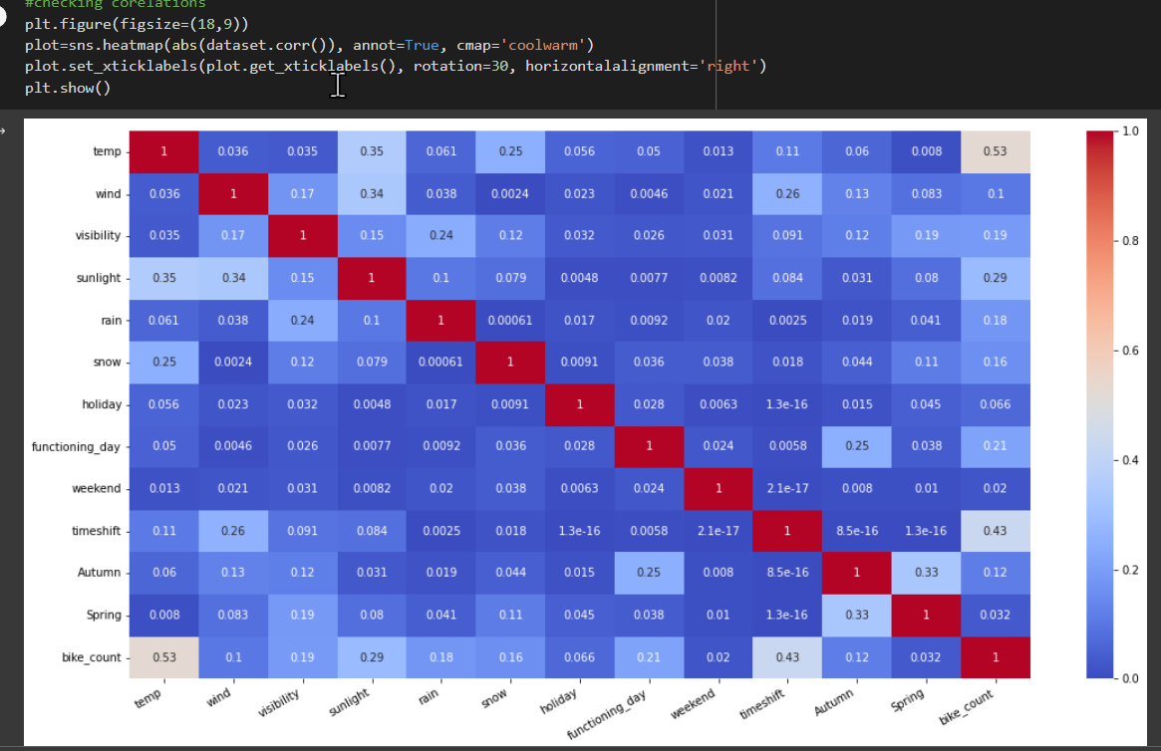
Updated Heatmap

Slide 22
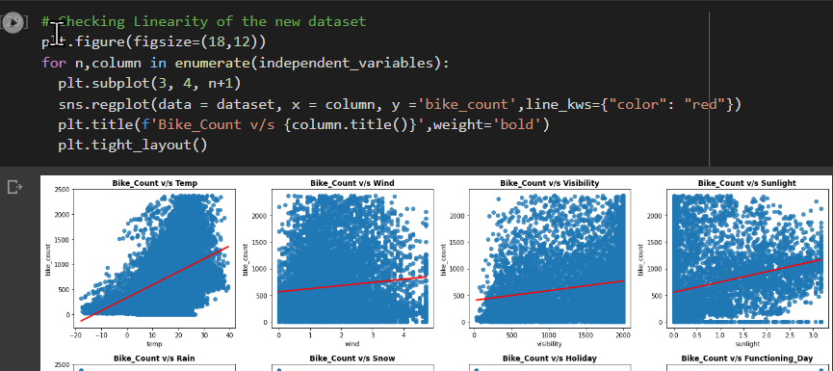
REGPLOTS (UPDATED DATASET)

Slide 23
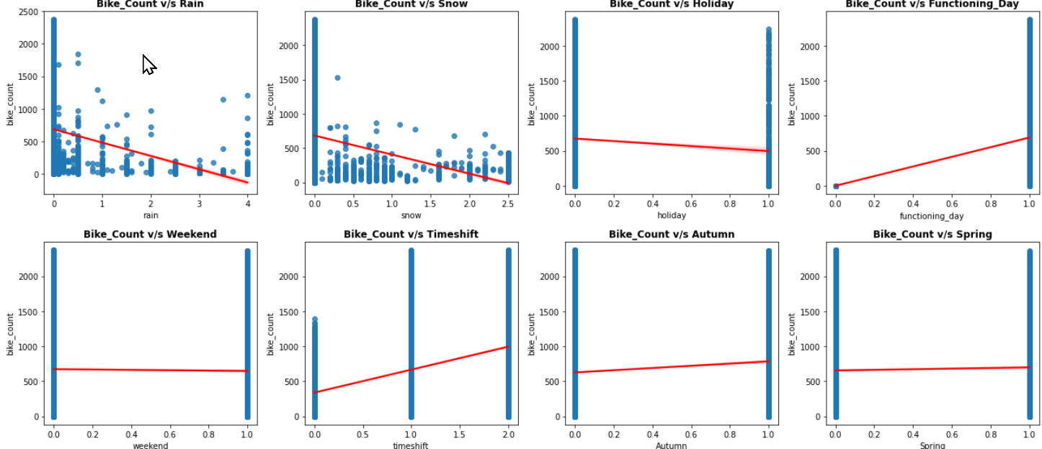
REGPLOTS (UPDATED DATASET)

Slide 24

MODEL BUILDING PREREQUISITES
Feature scaling or standardization is a crucial step in data pre-processing, specifically for independent variables or features. It involves normalizing the data within a particular range, which can improve the accuracy and efficiency of machine learning algorithms.
In this case, we used MinMax scaler, which is a form of normalization that scales our features to a predefined range, typically the 0-1 range. It accomplishes this by using the minimum and maximum values of each feature in the dataset.
By applying this technique, we ensure that all the features are on a similar scale, which is particularly useful when dealing with features that have significantly different ranges or units of measurement. Normalizing the data using MinMax scaler can also help to prevent certain features from dominating the model due to their larger scales or ranges.
Overall, feature scaling is an important step in data pre-processing that can improve the accuracy and efficiency of machine learning algorithms, and the use of MinMax scaler is a common technique for achieving this normalization.

Slide 25
MODEL BUILDING PREREQUISITES
▪ Defining a new function called analyse_model which takes model, X_train, X_test, y_train, y_test and prints evaluation matrix like MSE, RMSE, MAE, TRAIN R2, TEST R2 , ADJUSTED R2. Also plots the feature importance based on the algorithm used.
▪ We also defined some range of values for hyperparameters such as: ▪ Number of trees: n_estimators=[50,100,150] ▪ Maximum depth of trees: [6,8,10] ▪ Minimum number of samples required to split a node: [50,100,150] ▪ Minimum number of samples required at each leaf node: [40,50] ▪ learning rate : Eta=[0.05, 0.08, 0.1]

Slide 26
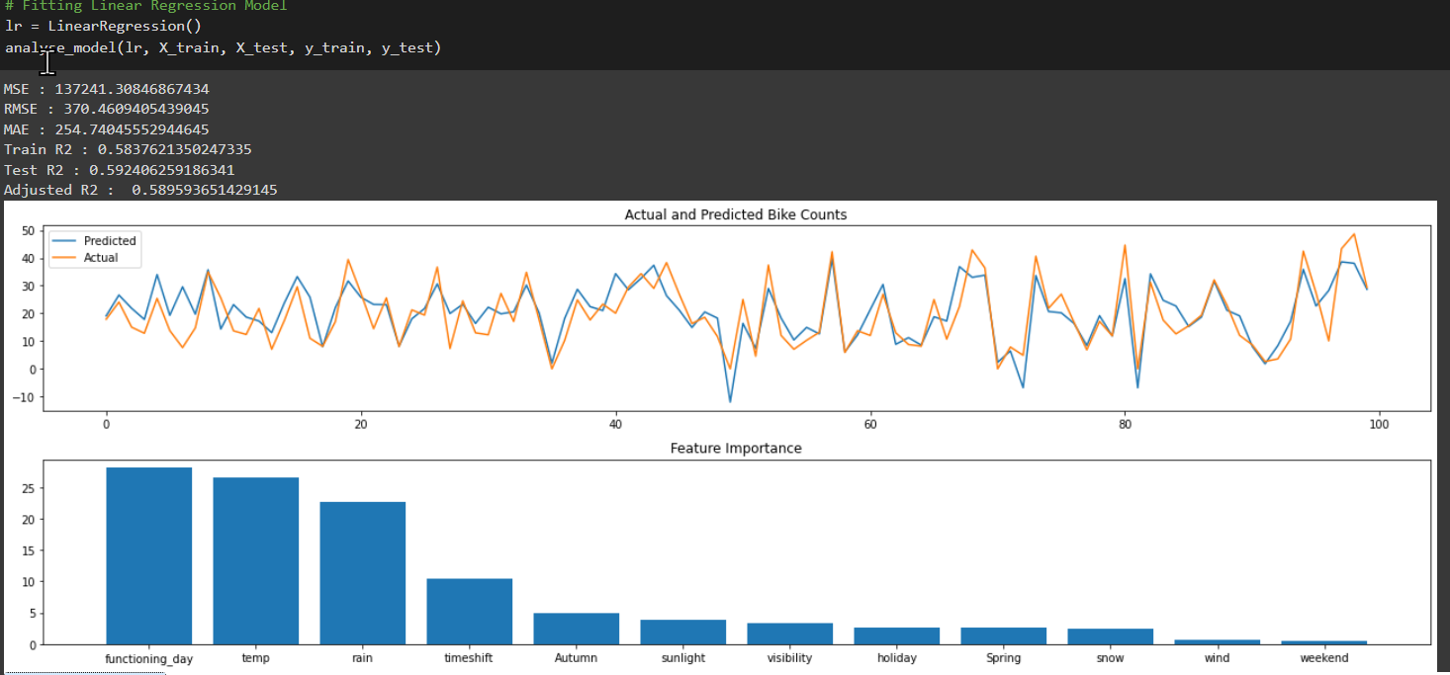
Linear Regression

Slide 27
LINEAR REGRESSION
▪ The absolute values of the beta coefficients were plotted, which is similar to the feature importance in tree-based algorithms.
▪ However, due to the poor performance of the simple linear model, we also experimented with more complex models to improve our predictive accuracy.

Slide 28
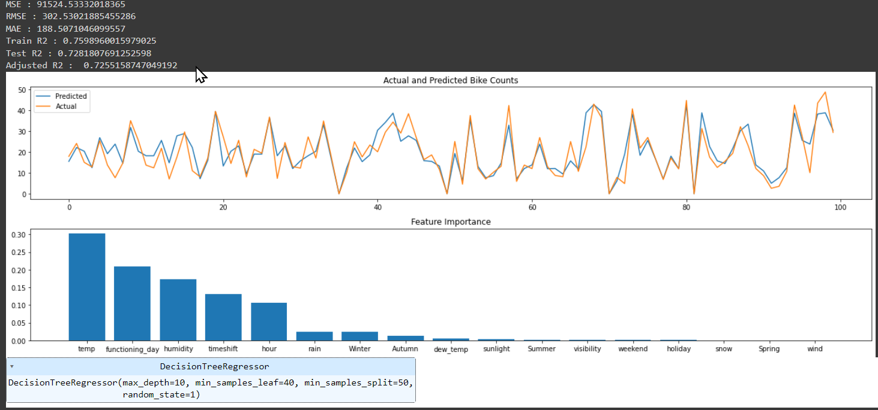
DECISION TREE

Slide 29
DECISION TREE
We utilized the DecisionTreeRegressor model with specific hyperparameters, including a maximum depth of 10, a minimum of 40 samples per leaf, a minimum of 50 samples per split, and a random state of 1.
The decision tree model performed significantly better than the linear regression model, with a test r2 score of over 70%. This suggests that decision tree models may be more appropriate for predicting bike counts in our dataset, as they can capture complex interactions between features and are less constrained by the assumptions of linear models.

Slide 30
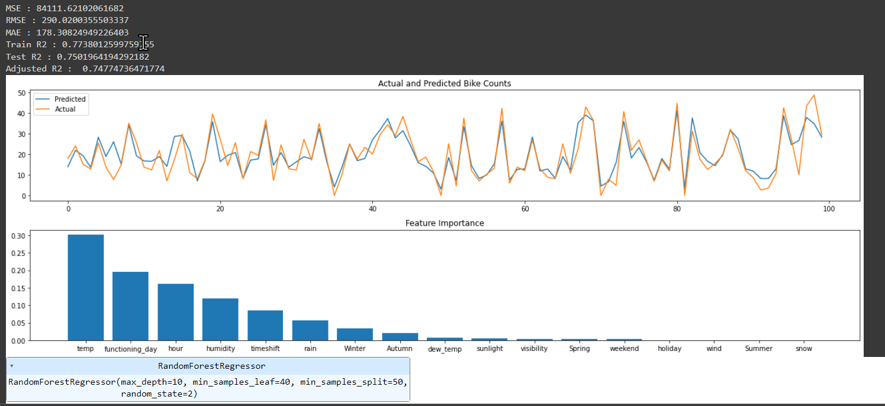
Random Forest Regressor

Slide 31
RANDOM FOREST REGRESSOR
We also utilized the RandomForestRegressor model with the same hyperparameters as the DecisionTreeRegressor model, including a maximum depth of 10, a minimum of 40 samples per leaf, a minimum of 50 samples per split, and a random state of 2.
The random forest model performed well in both the train and test datasets, with a r2 score of 77% on the train data and approximately 75% on the test data. This suggests that the random forest model may also be an appropriate choice for predicting bike counts in our dataset, as it can effectively capture the interactions between features and reduce the risk of overfitting compared to a single decision tree model.

Slide 32
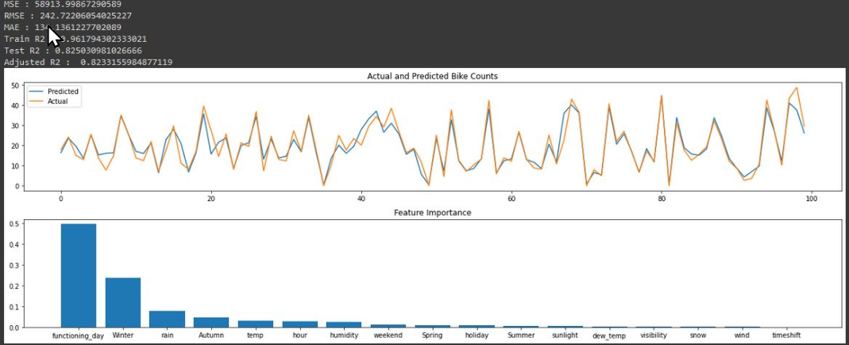
XgBoost Regressor

Slide 33
RANDOM FOREST REGRESSOR
▪ XGBRegressor(eta=0.05, max_depth=8, min_samples_leaf=40, min_samples_split=50, n_estimators=150, random_state=3, silent=True)
▪ XGBoost regressor emerges as the best model according to the evaluation matrix score both in the train and test.

Slide 34
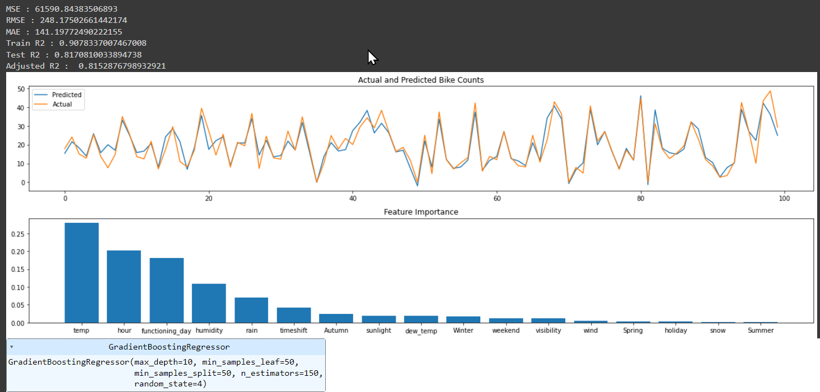
GRADIENT BOOSTING REGRESSOR

Slide 35
GRADIENT BOOSTING REGRESSOR
GradientBoostingRegressor(max_depth=10, min_samples_leaf=50, min_samples_split=50, n_estimators=150, random_state=4)
We experimented this boosting algorithm in order to enhance the performance but we found out that its performance is closely equal to the XGBoost model only.

Slide 36
conclusion
The linear regression model did not perform well on our dataset, likely due to the lack of a strong linear relationship between the independent variables and the target variable. In contrast, tree-based algorithms such as DecisionTreeRegressor, RandomForestRegressor, GradientBoostingRegressor, and XGBoostRegressor performed well on this dataset.
When using LinearRegressor, the most influential feature was functioning day, followed by temperature. In contrast, temperature was the most important feature for DecisionTreeRegressor, RandomForestRegressor, and GradientBoostingRegressor.
XGBoostRegressor was the only model to consider both whether it was winter and whether it was a working day as the two most important features. While winter is a function of temperature, it seems that this feature engineering trick gave better results for XGBoostRegressor.
Overall, XGBoostRegressor had the lowest root mean squared error of 242.72, making it the best model for this problem.

